Slide 1

AI Agents & Identity
Igal Miroshnichenko, SAP & Rakefet Jackoby Galazan, SAP
July 09, 2025

Slide 2
Agenda
Why Identity for AI Agents?
Our Vision
Glossary
What do we need to build & how?
How do we monetize it?

Slide 3
Why do we need Identity for AI?

Slide 4

Identity in AI Agents
Clear Attribution of Actions
Identity in AI agents ensures actions and decisions are clearly attributed, making it easier to trace their origins.
Building Trust and Accountability
A unique identity for each AI agent fosters user trust and accountability by clarifying responsibility for outcomes.
Personalized and Consistent Interactions
Distinct identities allow AI agents to personalize user interactions and maintain consistent behavior across contexts and platforms.
Notes:
Identity is crucial for AI agents, enabling clear attribution of actions and decisions. It fosters trust and accountability by allowing users to understand which agent is responsible for outcomes. Additionally, unique identities help personalize interactions and ensure consistent behavior across different contexts and environments.

Slide 5
Why do we need Identity for AI Agents?
AI agents are becoming increasingly autonomous and integrated into business operations, ecosystems, and decision-making processes.​ ​
Traditional identity and access management (IAM) systems, designed for human users and static applications, fail to meet the unique challenges posed by these agents. ​ ​
AI agents can generate outputs, access data, initiate actions, and even interact with other agents without direct human oversight. ​ ​
This introduces new risks in accountability, governance, traceability, and behavioral compliance. ​
​
Without AIAM, organizations risk: ​ ​
Uncontrolled or rogue agent behavior. ​
Difficulty in auditing and compliance reporting. ​
Security breaches via impersonated or cloned agents. ​
Lack of human oversight over decisions and interactions initiated by autonomous entities. ​
​
Notes:
Identity is crucial for AI agents, enabling clear attribution of actions and decisions. It fosters trust and accountability by allowing users to understand which agent is responsible for outcomes. Additionally, unique identities help personalize interactions and ensure consistent behavior across different contexts and environments.

Slide 6
Artificial intelligence “agents” are set for explosive growth worldwide in the next five years
Analysts project that the deployment of AI agents will expand across consumer technology, enterprises, manufacturing, healthcare, and other sectors, transforming how we live and work
Chatbots
Digital Voice Assistants
AI Agents
Industrial AI
AI Analytics
anchored in business context
Digital Sales Reps
Self Driving Vehicles
Autonomous Systems

Slide 7


What’s unique about AI Agents? Isn’t it just another Application?

Slide 8
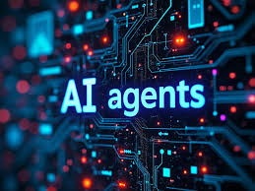
Key Differentiators: Agentic Identity vs. Human Identity
​
Feature | Human Identity Management | Agentic Identity Management
Nature of Identity | Biological/psychological entity with persistent identity. | Programmatic construct with mutable parameters and behavioral autonomy.
Authentication | Passwords, biometrics, MFA. | Cryptographic keys, signed manifests, model fingerprints.
Intent Management | Assumed and self-regulated. | Explicitly declared and needs to be governed via machine-readable contracts.
Lifecycle | Long-term, often stable. | Short-lived or longed lived, versioned, frequently updated or terminated.
Auditability | Focus on access logs and activity history. | Requires provenance tracking of decisions, actions, and outputs.
Governance | Hierarchical, role-based. | Decentralized, potentially federated across agent networks.
Trust Model | Based on known user behavior and org hierarchy. | Requires continuous trust scoring and behavior validation.
Notes:
Identity is crucial for AI agents, enabling clear attribution of actions and decisions. It fosters trust and accountability by allowing users to understand which agent is responsible for outcomes. Additionally, unique identities help personalize interactions and ensure consistent behavior across different contexts and environments.

Slide 9



Plain Old Applications
Authentication:
User Identity
Client Authentication
Technical User
Authorization:
End user permissions
Client Scopes
Trust Establishment:
1st party applications (preconfigured)
3rd party applications (oidc consent)
API
User
Client User-Agent
API

Slide 10

AI Agent Architecture
Authentication:
User Identity
Client Authentication
Technical User
Authorization:
End user permissions
Client Scopes
Trust Establishment:
1st party applications (preconfigured)
3rd party applications (oidc consent)
API - Tool
User
Client AI User-Agent
API - Tool
LLM

Slide 11

AI agent requires different considerations because it infers actions from natural language rather than following fixed workflows, introducing greater unpredictability and risk.

Slide 12
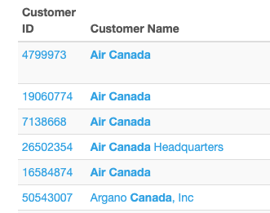
How does inference work?
What’s the CDC contract end date for Air Canada?
Call getLicense(customerID, productid)

Slide 13
What happens when the Agent has more privileges than the user
Can you help me with delay on my PO 123?
Call getPO(Purchase Order: 123)

Slide 14

Confused deputy problem
The confused deputy problem is a security vulnerability where a program (the "deputy") that has authority to perform certain actions is tricked into misusing its authority on behalf of another entity. This happens when the program cannot properly distinguish between its own permissions and those of the requester.
In the context of AI agents, this means the agent—acting with the user’s full permissions—might unknowingly perform sensitive operations that the user didn’t intend, simply because it was asked to in a way it interpreted as valid. The agent becomes a "confused deputy," unintentionally misusing its authority, potentially leading to privilege escalation or data leakage.

Slide 15
Glossary of AI Identity

Slide 16





AI Agent
AI Agents are multifaceted
they have different meaning in different contexts
Agents are applications that encapsulate some business process.
They are also unattended users that can interact with the world without human intervention.
They serve as an integration point which can lead to multiple credentials in multiple systems.
Application
Unattended User
Downstream Credentials
Multi-tenant
???

Slide 17
Each Hyperscaler & Strartup are building an Agent Runtime
Each hyperscaler is building a complete agent runtime to lure customers to build & run their agents on their platform
Create a store for both ready made agents and tools
Offer a robust ecosystem of cross cutting concerns to fence in customers to their eco-system.
SAP is also building this using Joule and Agent Core
Unified Chat Assistant – Joule / Co-Pilot / Gemini / Claude
Agents
Orchestrator
Tools
Agent Store
Tool Store
ADE
Easily install existing agents
Connect to pre-existing Applications via tools
Build & Run Your own agents
Cross Cutting Concerns
Identity
Traceability
Lifecycle Management
Runtime
Notes:
Intelligent Applications complement transactional applications like ERP and HCM leveraging underlying data models, ML models and analytics within BDC to provide personalized user experiences. These personalized experiences help business users understand various aspects of their operations. Additionally, intelligent applications offer insights, recommendations and facilitate actions to enhance outcomes that matter to the business user.
Intelligent Applications provide line of business users with ready-to-use insights to improve decision making and to take action on critical business signals.
Built by SAP utilizing decades of industry and functional experience.
Insights are enhanced with AI/ML to uncover hidden insights and improve decision-making.
Built on BDC allowing customers to easily enrich and/or extend intelligent application use cases leveraging SAP and non-SAP data

Slide 18
Lifecycle of an AI agent
Design
Installation
Tools Configurations
Prompts
Tools
Boundary conditions
Credentials
Tool Extensions
Runtime
Runtime Grants
Authorizations
Personal User tools
Authorizations
Agent Developer
IT Admin
End User

Slide 19
Tools available to AI Agents
Persona
AuthZ Policies
End User
Runtime
End User Grants
Google Calendar
IT Admin
Specific Tenant Policies
Install Time
Vendor Selector
Agent Developer
Design time tools
Design Time
Purchase Order

Slide 20
Authorization Policies for AI Agents
Persona
AuthZ Policies
End User
Runtime
End User Tools
Grant Access to my direct employees
IT Admin
Extensions and Customizations
Install Time
Only HR department
Agent Developer
Static Policies
Design Time
Only Basic Information

Slide 21
So What do we need to build?

Slide 22

Our Vision for Agentic Identity Management
The vision of Agentic Identity Management is to become a leading trusted foundation of our customers intelligent agent economy.
As AI agents evolve from simple tools into autonomous participants in systems, they must be held to the same or higher standards of transparency, accountability, and control as human actors.
We see AIAM not just as a security layer, but a foundational element in designing ethical, secure, and collaborative digital ecosystems where humans and machines work together with clarity, safety, and trust.
SAP AIAM framework will:
Enable responsible agent deployment through secure identity provisioning.
Allow human oversight and collaborative governance across agent ecosystems.
Provide regulators and enterprises with auditability and behavioral compliance.
Support interoperability across platforms, cloud environments, and organizations.
Foster trust in agent-based systems by embedding ethical constraints and explainability.

Slide 23




MCP AuthZ Gate
SAP managed
Sap Identity Suite MCP AuthZ Gate
Joule
End User Context
SAP Agent
Identity
Code Base
Grants
Generic Tools
Id_token
SAP Tool
…
Groups
Agent bound downstream token
Custom managed
ABAP
Agent Context
Agent Certificate
Customer Tools
CDS
Identity
Custom
Installation data
User, Agent, Tool Authentication Access Policy decision User Grant Verification Context bound principal propagation
Policies
External
Grants
External Tools
Cloudflare
Github
Notes:
Trusted out-of-the-box data products eliminate time-consuming and tedious data integration and preparation

Slide 24
SAP Identity Gate For AI Agent
Agent Registry
Onboarding
SAP Services
SAP Agent Hub
SAP Managed
SAP Managed Client
SAP Customer Client
External Client
UCL
Broker
Joule
ABAP
GitHub Copilot
UCL
SAP Agent
CDS
Microsoft Teams
AMS
Credentials Vault
Connectivity
MCP AuthN Gate
SAP Customer Agent Hub
Customer Managed
Consent Vault
Auth Server
Grant & Consent
AuthZ
Interpolation
Identity Store
Grant Management
Permissions API
Fed IDP
CDC Identity
Customer Built Agents
OAuth APIs
Consent
Policy Engine
XSUAA
SCI
Authentication Tools
Backchannel
Groups
Dynamic DCR
Audit Log
External Agent Hub
MCP AuthZ Gate
AWS bedrock.
SAP LoB MCP Servers
SAP Managed
SAP Customer MCP
Customer Managed
Non-SAP MCP Servers
External
.Composio
HCM
ISBN
Local
Github
Custom
S4 ABAP
S/4HANA PCE
CDS
Connectivity
Cloudflare
AWS
VSCode (config)

Slide 25
How do we sell it?

Slide 26
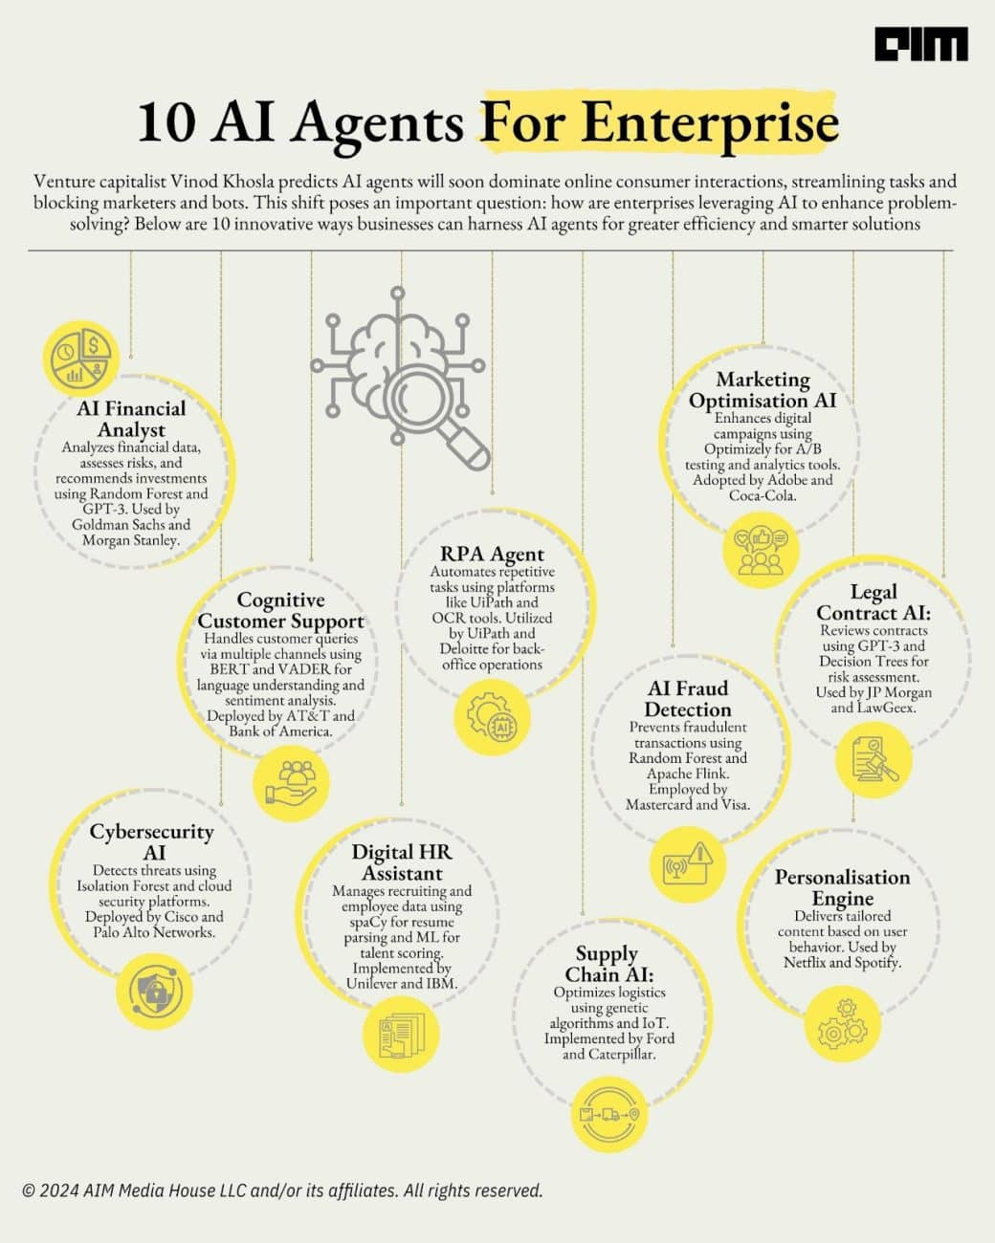
Enterprises will adopt AI across the board
Best of Breed Agents will come from various providers and startups.
What will be in common for them is integration with enterprise data , access, context and traceability.
While each Agent runtime will offer its own identity framework, enterprises will look to consolidate all their agent identity and access in a single unified location regardless of the agent & runtime of choice of each department.

Slide 27
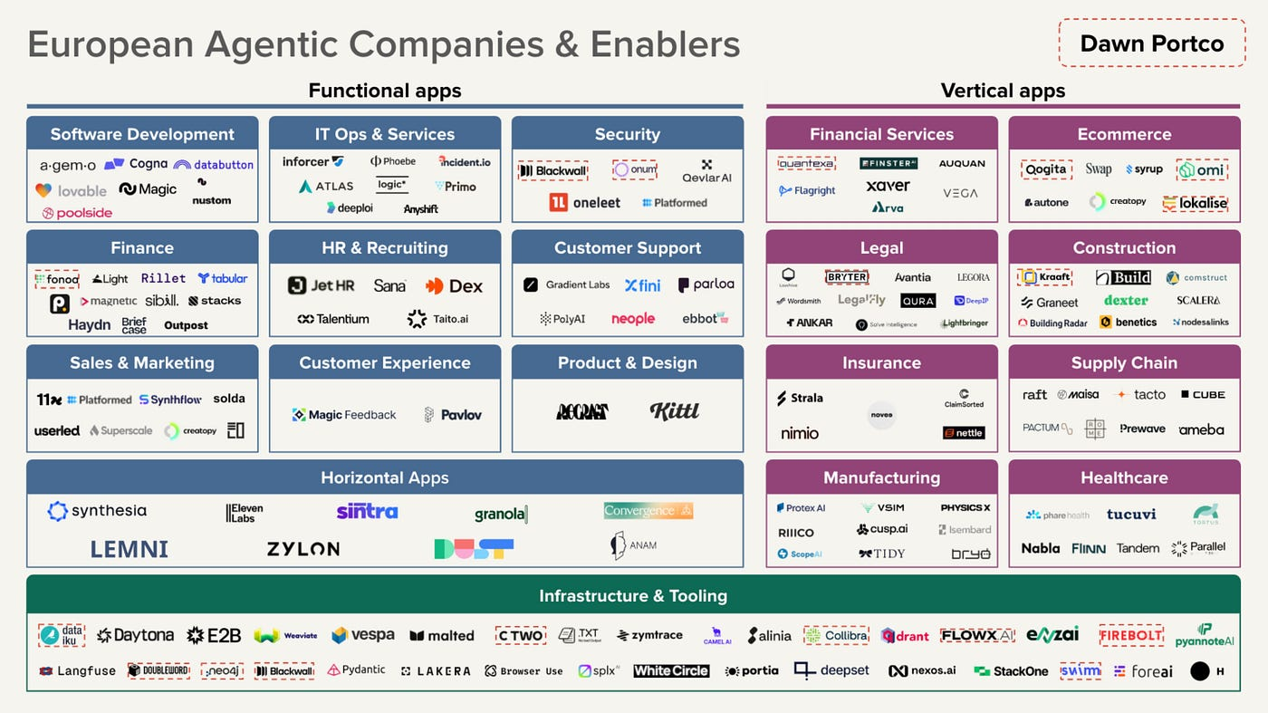

Slide 28
AIAM MVP
Agent Identity Creation & Registry
Identity lifecycle management
Authentication
Authorization (RBAC/ABAC Lite)
Behavioral Intent Declaration
Audit Logging
UI dashboard (Basic)
API for Agent Onboarding and Verification

Slide 29
Thank you.
Name
Email

